Slide 1
Introduction to Programming in Python
Working with APIs

Slide 2
APIs
API requests & responses
Requests Methods
GET
POST
PATCH
DELETE
Work with real APIs like GitHub

Slide 3
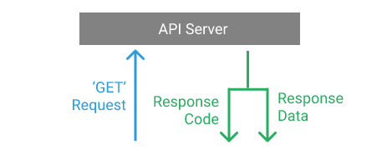
What’s an API?
An API, or Application Programming Interface, is a server that you can use to retrieve and send data to using code. APIs are most commonly used to retrieve data from a source and display it to a software application and it’s users.
When we want to receive data from an API, we need to make a request. Requests are used all over the web.

Slide 4
Python API Requests and Response Codes
Any request made to a server of any kind always returns a response object, that response consists of multiple parts.
There are two parts of that response that are important for using APIs, one is called the status code and the other is the response body.
The status code is used to indicate the status of the request, such as if it’s succeeded or failed.

Slide 5
Status Codes
200 (OK): Error-free success with a response.
301 : URL redirect
400: Bad request
401 (UNAUTHORIZED): Access denied
403: Forbidden request
404: Not found
503: Server error
Code range | Category
2xx | Successful operation
3xx | Redirection
4xx | Client error
5xx | Server error

Slide 6
Making API Requests in Python
In Python, the most common library for making requests and working with APIs is the requests library.
The requests library isn’t part of the standard Python library, so you’ll need to install it to get started.
pip install requests //for linux
python -m pip install requests // for windows

Slide 7
The requests module allows you to send HTTP requests using Python. The HTTP request returns a Response Object with all the response data (content, encoding, status, etc.).
It has the various methods, such as:
Delete
Get
Post
Put
Request

Slide 8
Making Our First API Request: GET method
To make a ‘GET’ request, we’ll use the requests.get() function, which requires one argument — the URL we want to make the request to. We’ll start by making a request to an API endpoint that doesn’t exist, so we can see what that response code looks like
import requests
response = requests.get('https://www.craftknowledge.net/yourfile’)
print(response.status_code)
Output: 404 //doesn’t exist
Notes:
The ‘404’ status code might be familiar to you — it’s the status code that a server returns if it can’t find the file we requested. In this case, we asked for yourfile which didn’t exist!

Slide 9
Working with JSON Data in Python
JSON (JavaScript Object Notation) is the language of APIs.
JSON is a way to encode data structures that ensures that they are easily readable by machines.
JSON is the primary format in which data is passed back and forth to APIs, and most API servers will send their responses in JSON format.
When interacting with APIs we use a standardized template for sending and receiving data so both the client (us) and the API can process the data correctly — this format is the JavaScript Object Notation (JSON).

Slide 10
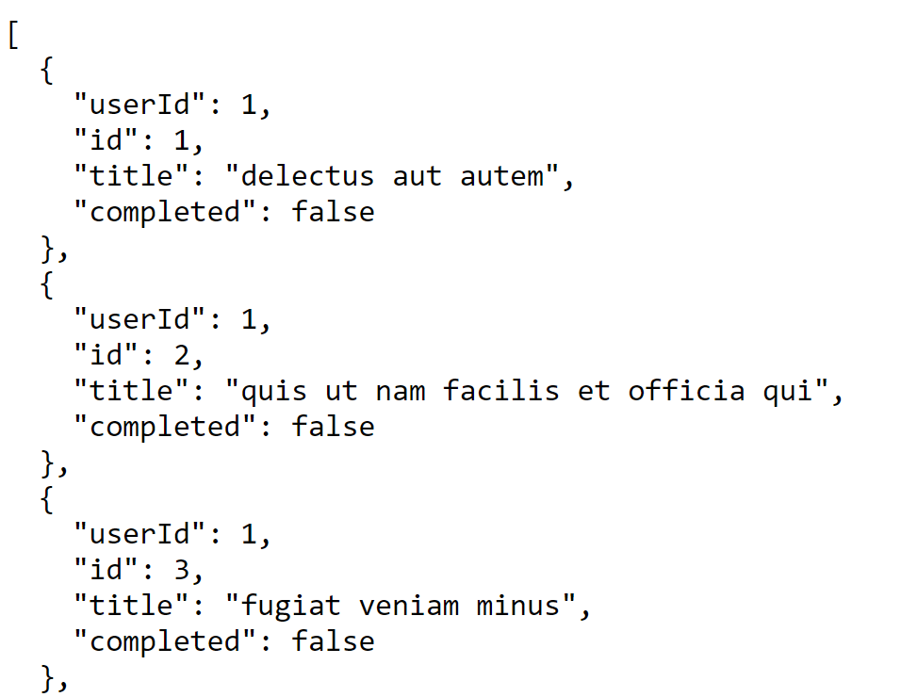
JSON output we receive from the API looks like it contains
Python dictionaries,
lists,
strings, and
integers.
You can think of JSON as being a combination of these objects represented as strings.
See example →

Slide 11
API endpoints
To test out GET and the other methods in this section, you’ll use a service called JSONPlaceholder. This free service provides fake API endpoints that send back responses that requests can process.
A REST API exposes a set of public URLs that client applications use to access the resources of a web service. These URLs, in the context of an API, are called endpoints.
Example:
In the following url, https://jsonplaceholder.typicode.com/todos,
/todos is an endpoint
/todos/1 is another endpoint

Slide 12
Send a Get request to a JSONPlaceholder endpoint
import requests
api_url = 'https://jsonplaceholder.typicode.com/todos/1’
response = requests.get(api_url)
print(response.status_code)
print(response.json())

Slide 13
In A method definition
import requests
def jsonPrint(url):
response = requests.get(url)
print(response.json())
// call the method jsonPrint('https://jsonplaceholder.typicode.com/todos/1')

Slide 14
Json packages
Python has great JSON support with the json package.
We can both convert lists and dictionaries to JSON, and convert strings to lists and dictionaries.
The json library has two main functions:
json.dumps() — Takes in a Python object, and converts (dumps) it to a string.
json.loads() — Takes a JSON string, and converts (loads) it to a Python object.
The dumps() function is particularly useful as we can use it to print a formatted string which makes it easier to understand the JSON output, like in the diagram we saw in the previous slide:

Slide 15
import requests
api_url = 'https://jsonplaceholder.typicode.com/todos/1’
response = requests.get(api_url)
json_result = response.json()
output = json.dumps(json_result,sort_keys =True,indent = 4)
print(output)

Slide 16
Types of requests
GET — Retrieve information from the API.
POST — Create a new resource (e.g., add a new data record).
PUT — Update an existing resource (e.g., change specific value in existing record).
DELETE — Delete an existing resource (e.g., delete a data record).

Slide 17
POST
import requests
api_url = 'https://jsonplaceholder.typicode.com/todos/1’
my_todo = { "userId": 1, "title": "Swim at Lake Tana", "completed": False}
res = requests.post(api_url, json = my_todo )
print(res.status_code)
print(res.json())

Slide 18
PATCH
requests.patch() is used to modify the value of a specific field on an existing todo.
PATCH differs from PUT in that it doesn’t completely replace the existing resource. It only modifies the values set in the JSON sent with the request.
Use the same todo from the last example to try out requests.patch().
Notes:
PATCH applies a partial update to the resource.

Slide 19
import requests
api_url = 'https://jsonplaceholder.typicode.com/todos/10’
my_todo = {"title": "Car wash"}
res = requests.patch(api_url, json = my_todo )
print(res.status_code)
print(res.json())

Slide 20
DELETE
import requests
api_url = 'https://jsonplaceholder.typicode.com/todos/10’
res = requests.delete(api_url)
print(res.status_code)
print(res.json())

Slide 21
How can we use real APIs like GitHub API
Authorization — most APIs need us to include an authorization key with our calls, if we miss this — we’ll usually return a 4xx code telling us we need authorization.
Many APIs require you to register and obtain an API key in order to make API calls
To get github APIs key, go to your github profile and generate Personal access tokens.
Once you have the authorization key, we will use it to authenticate all of our requests to the GitHub API like so:

Slide 22
import requests
from pprint import pprint
url = 'https://github.com/username' // use your user name
user_data = requests.get(url).json()
pprint(user_data)

Slide 23
Let’s create a repository in our GitHub account using Python.
import requests, json
payload = {
'name': "my_python_repo",
'public': "true"}
token = 'ghp_H0ddt8v3khzer' //generate one for yourself
url = 'https://api.github.com/user/repos’
res = requests.post(
url,
headers = {'Authorization': f'token {token}’},
data = json.dumps(payload))
print(res)
Notes:
We can think of headers as the metadata we include alongside our request.

Slide 24
Using the data parameter of our request, we describe what we would like to do. In here we include our payload which is a Python dictionary converted into a JSON format string using json.dumps
From that we will return the 201 Created response code — which tells us that the request was successful and we have created a new resource.
To check the result, we can head over to Github.

Slide 25
https://www.dataquest.io/blog/python-api-tutorial/
https://realpython.com/api-integration-in-python/
https://rapidapi.com/blog/how-to-use-an-api-with-python/

